Slide 1

Dayalbagh Educational Institute
Mobile Computing – Mobile application
DATA ENTRY APPLICATION
Submitted by: Kapil Srivastava, Kartikeya, Mohd. Shabaz
Roll No. : 1700644, 2002051, 2002061
Branch : Civil CS
Submitted to:
Prof. K Srinivas

Slide 2

OVERVIEW
The data entry app is designed to facilitate the collection, validation, and storage of user inputs into a structured database. This app can be used in various scenarios, such as surveys, inventory management, customer information collection, and more.
# Key Features include :
User Interface (UI)
User Authentication
Backend and Database
CRUD Operations
Data Management
Search and Filter

Slide 3
Functionalities provided
User Interface and User Experience
Data Entry Features
Integration and Data Management
Security and Compliance
Reporting and Analytics
Mobile Compatibility
User Support and Documentation
Customization and Personalization

Slide 4
Sample Video

Slide 5
Applications
1. Business and Administration
2. Healthcare
3. Education
4. Finance and Accounting
5. Human Resources
6. Logistics and Supply Chain

Slide 6
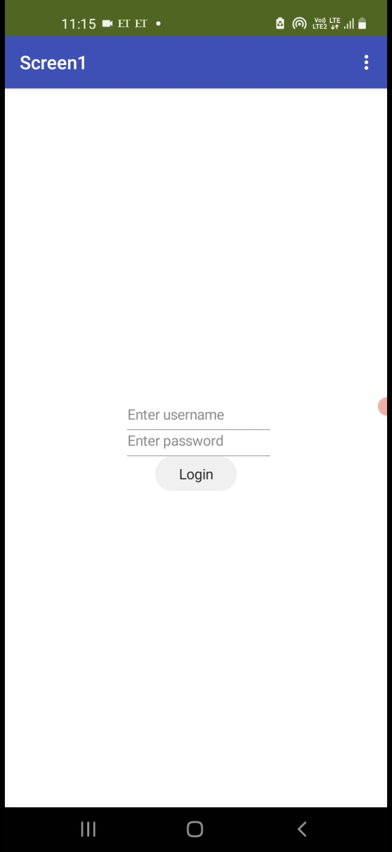
Walkthrough
Authentication Page
Design a screen with input fields for username and password.
Implement validation to ensure correct credentials are entered.
Provide options for user authentication, such as entering a username and password.

Slide 7
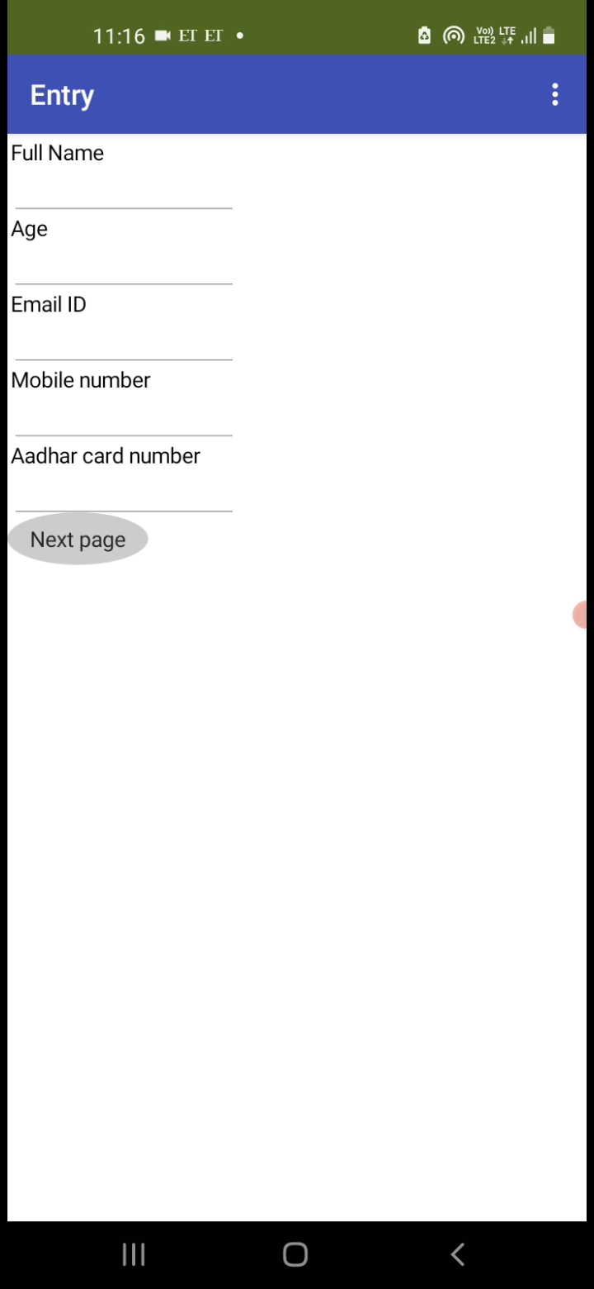
Data Entry Page
Create a new screen for data entry with fields for full name, age, email id, mobile number, and Aadhar card number.
Use appropriate input components (textboxes, dropdowns, etc.) for each data entry field.
Include a "Next Page" button to proceed to the next step.

Slide 8
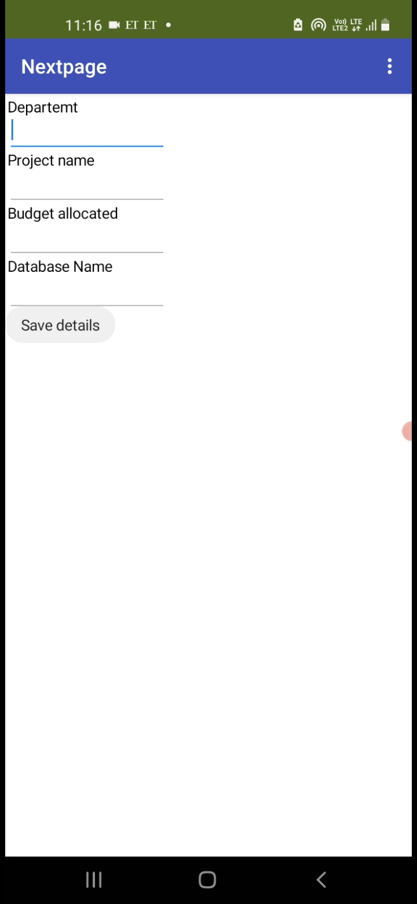
Details Entry Page
Design a new screen for entering additional details like department, project name, budget allocated, and database name.
Utilize appropriate input components for each detail (textboxes, dropdowns, etc.).
Include a "Save Details" button to save the entered information.

Slide 9
Saving Details
Implement functionality to save the entered details to a database or storage system.
Use MIT App Inventor's data storage options (e.g., TinyDB, Firebase) to store the information securely.
Validate the entered data to ensure accuracy and completeness before saving.

Slide 10
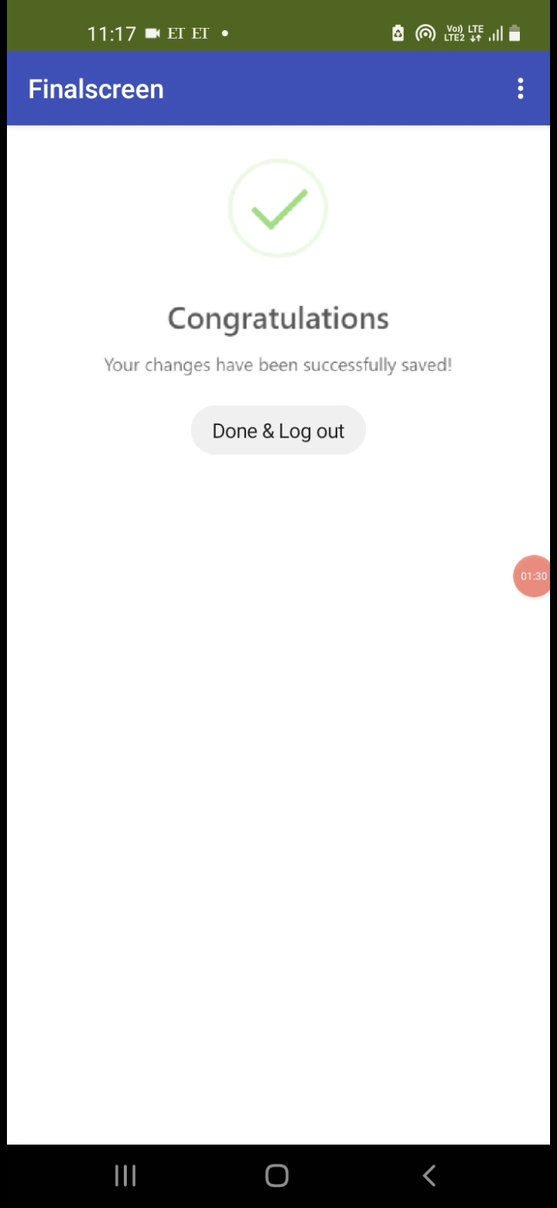
Acknowledgement Page
Create a final screen to display a congratulatory message upon successful data entry and saving.
Provide options for the user to navigate back to the main menu or exit the app.
Customize the design and layout to make the congratulation page visually appealing.

Slide 11
Scope of improvement
UI Enhancement
Accessibility Features
Multi-platform Support
Customization Options
Feedback Mechanism
Integration with External Services

Slide 12



THANK YOU
kapilsrivastava2312@gmail.com
kartikeya2002agra@gmail.com
mohammadshabaz2020@gmail.com

